Slide 1
An Exploration of Exoplanet Detection Methods
Group 5
Dax Begeny, Matthew Williard, Greg Costa, Omar Kotrach

Slide 2
5243
Transits
Radial Velocity
Microlensing
Exoplanets discovered to date
Astrometry
Direct Imaging
Notes:
-explain the significance and search for exoplanets
-Touch on how with all this data, it is important to analyze trends in exoplanets to greater understand the structure and formations of solar systems
-Further, talk about how there are many different methods to discover and analyze exoplanets
-quickly go into what they are and how much they are used today
-Lastly, touch on how we will be comparing the methods

Slide 3
Methods
Download NASA Exoplanet Data
Create Various Plots
Overplot Solar System Planets
Check Sensitivities of Detections
Simulate Jovian Planet Around Sun-like Star
1
2
3
4
5
Notes:
-here, first explain that we will download data from the NASA Exoplanet Archive, where we will then plot various variables against one another to notice any trends
-Then, we will overplot our solar system’s planets to more easily see the differences between our planets and discovered exoplanets
-Note how Dax took the lead on this, with us three double checking his work as he has the most experience in Python
-We then plotted the sensitivities of the various exoplanet detection techniques to check how sensitive they were to detecting different plants?
-Lastly, explain we chose to simulate a jupiter like planet around a sun like star. Maybe say why we did this (we are familiar with jupiter and our sun, allowing a better understanding the analysis?)

Slide 4
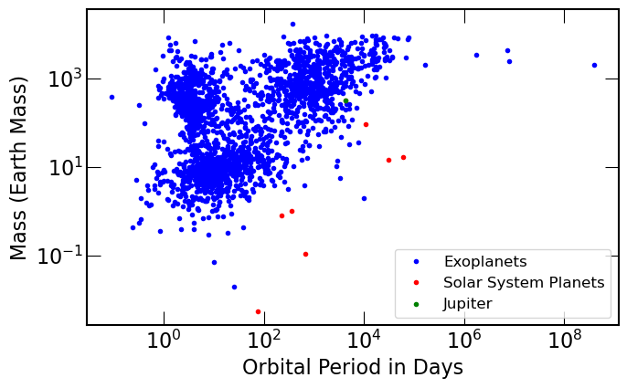
Plot 1: Mass v. Period
Notes:
Note the trend in the points
Note the clusters of data
Compare our planets to the exoplanets
-Reason there are not as many planets further out is bc we can not detect them–confir

Slide 5
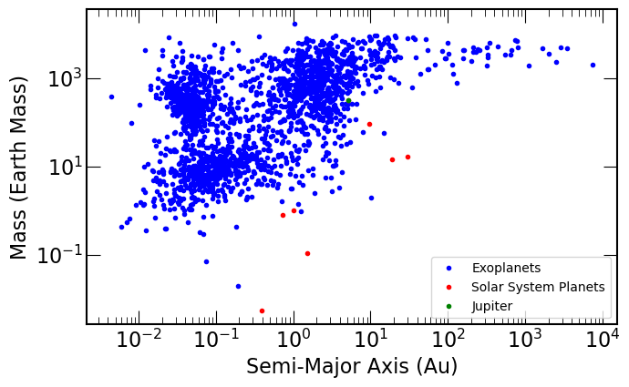
Plot 2: Mass vs. Semi-Major Axis
Notes:
Note the trend in the data
Note the clusters of data
Compare our planets with the exoplanets

Slide 6
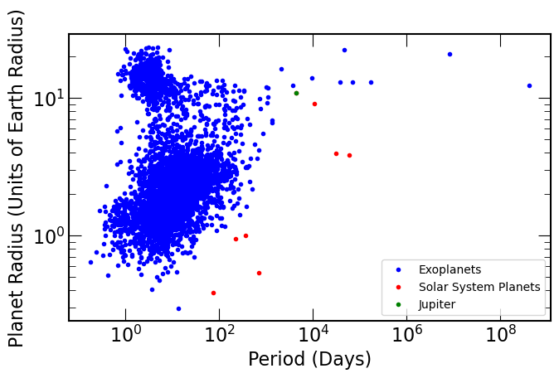
Plot 3: Radius vs. Period
Notes:
wrong

Slide 7
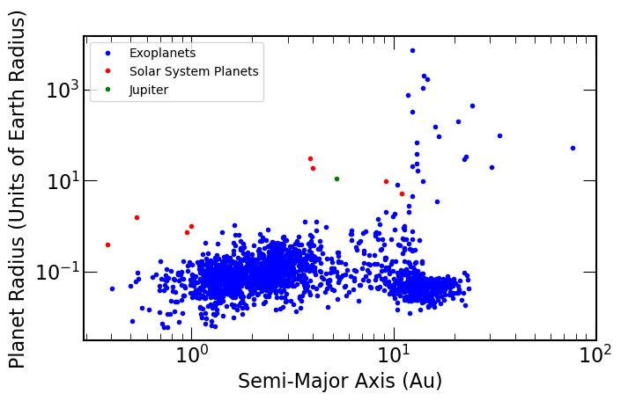
Plot 4: Radius vs. Semi-Major Axis

Slide 8
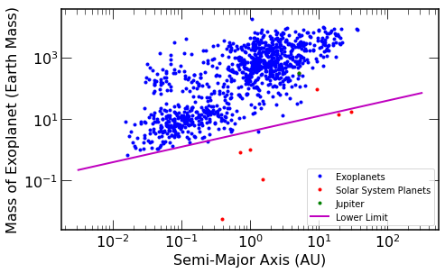
Radial Velocity Sensitivity

Slide 9
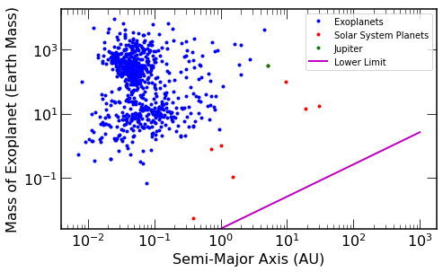
Transit Sensitivity

Slide 10
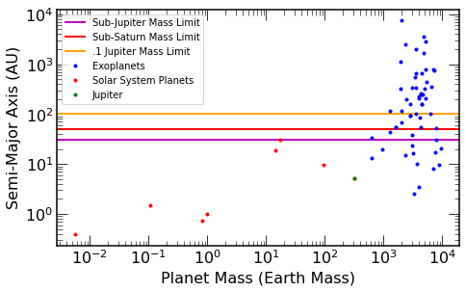
Direct Imaging Sensitivity
Notes:
Projection done by the JWST wich would

Slide 11
Conclusion
-Strengths vs. Weaknesses
-Confirmation Bias
-Occurence Rate Method

